Slide 1
Multi-Image Classification TensorFlow - Keras

Slide 2

TensorFlow Basics
End to end open source platform for machine learning.
Comprehensive and flexible ecosystem of tools, community tools and libraries.
Made open source, developed by a research team at Google.
Neural Networks
CNN
Takes input image, assigns importance to various aspects in it to differentiate image classes.
RNN
Uses sequential data or time series, typically used for ordinal or temporal problems
ANN
Universal neural network used for non-linear statistical data modeling, tabular, image or text data.
Notes:
CNN does not require

Slide 3
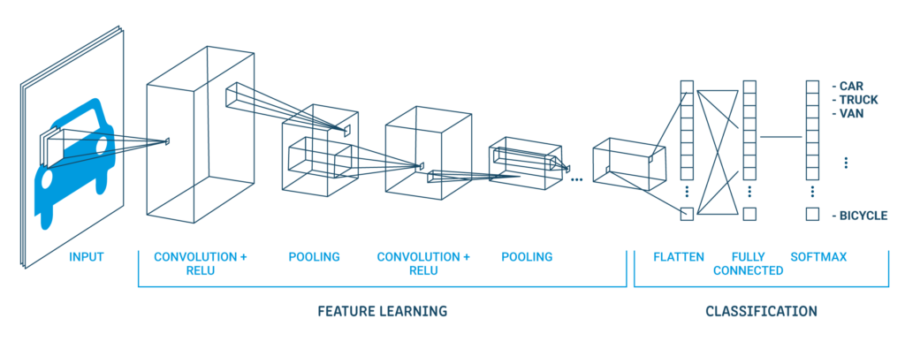
Hidden Layers and Filters in a CNN
A filter is generally used to extract the main features from an image like edges or high lighted patterns
Each layer in CNN, a small size filter is moved across the image to perform convolution operations.
Standardization
Convolution2D
MaxPooling2D
How does a CNN work?
Flatten
Dense

Slide 4
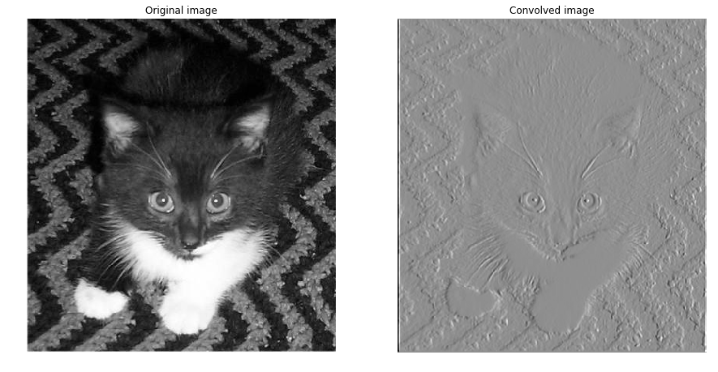
Computer POV of Convolved Image

Slide 5
A Convolutional Neural Network (CNN) At Work!
Convolutional Neural Network is a deep learning algorithm that takes an input image, learns about the important aspects of the image, and is able to differentiate it from one another.
Features of ConvNet 2D:
Captures spatial and temporal dependencies
Reduces images in a form that is easier to process
ConvNet 2D

Slide 6
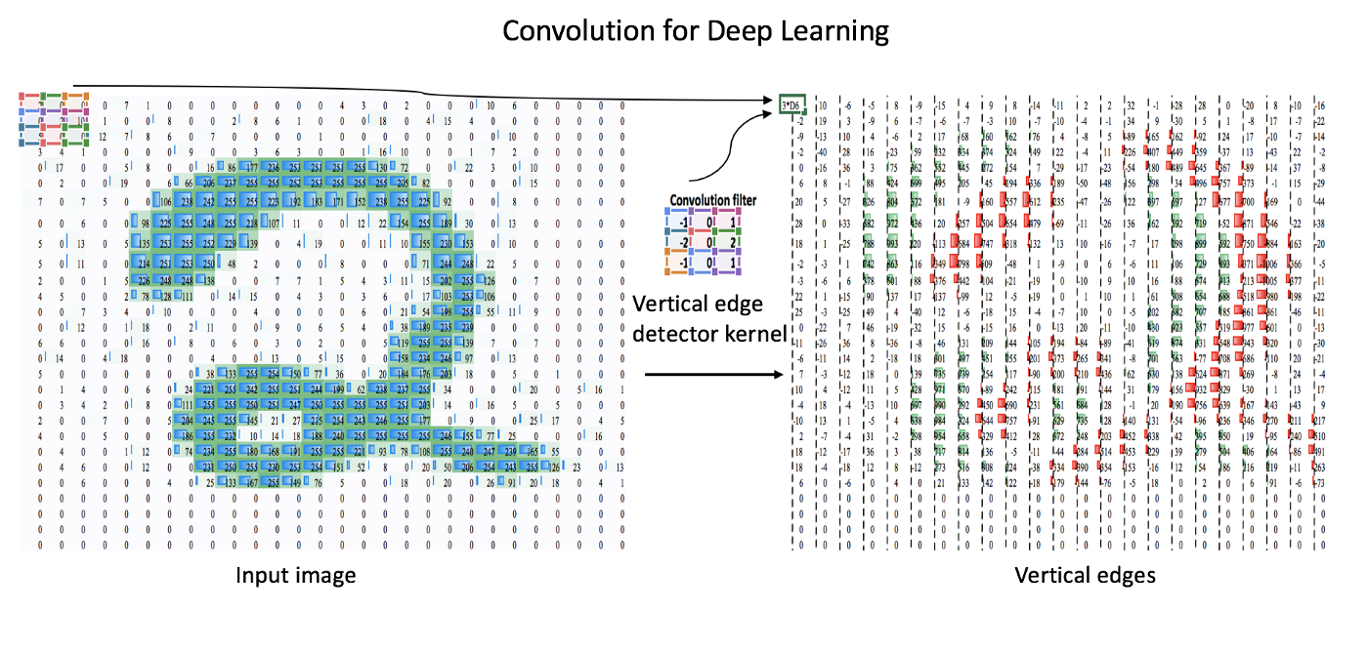

Slide 7
MaxPooling2D
Why MaxPooling2D?
-Alternative for downsampling to capture sharp features of an image
-Takes the maximum value over an input value determined by pool size
-Reduces variances and computations

Slide 8
Flatten Layer

Slide 9
Activation Function
An Activation Function defines an output of a neuron given a set of inputs.
Decides whether a neuron should be activated or not and it adds non linearity to the neural network.
Why use Relu activation function?
-Doesn't activate all the neurons at the same time

Slide 10
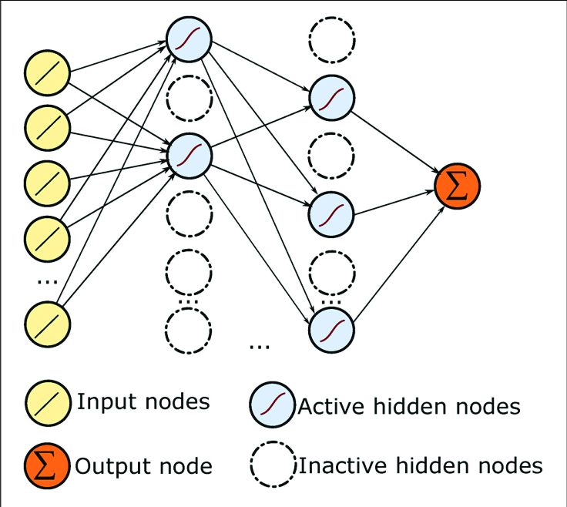
Applying Dropout to the Model
Why use a Dropout layer?
- Randomly sets neurons within hidden layers to 0 at a rate between 0 and 1
- Dropout layers at the end of layers stack usually take values of 0 or less
- Dropout layers within hidden layers typically take values between 0.5 and 0.8
- This is used to reduce overfitting on the training set

Slide 11
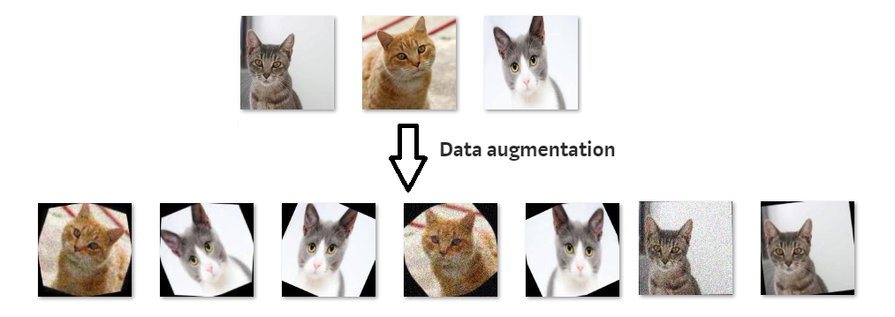
Data Augmentation and Additional Layers
Intermediate Dropout Layers:
Due to the increase in hidden layer volume and density, we now add intermediate dropouts at a frequency of 50% within some deeper hidden layers.
Kernel Constraints:
Furthermore, due to volume and density increase, we now have to add constraints to our later hidden layers so that weights stay relatively balanced as we go deeper into our network.
Data Augmentation Techniques Include:
Vertical and horizontal flipping
Random Rotating
Translation (Image is moved along X, Y direction)
cropping
Zooming
Darkening & brightening/color modification

Slide 12
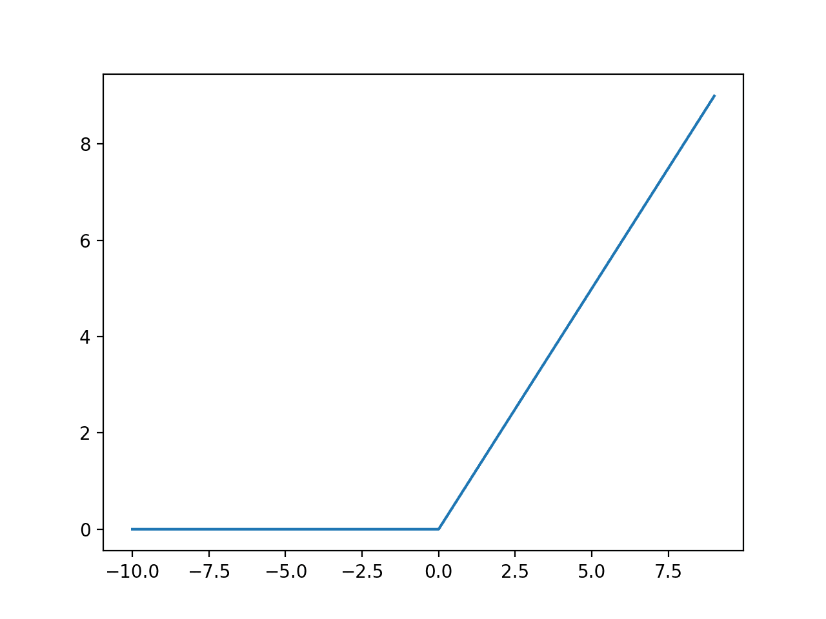

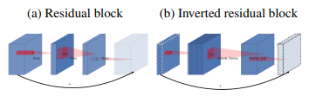
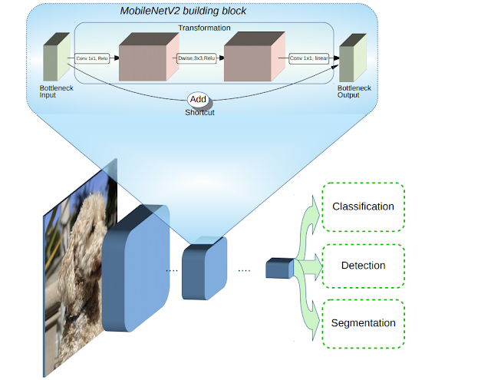
Pretraining on MobileNetV2
MobileNetV2 is an improved CNN algorithm by Google is based on an inverted residual structure where the input and output of the residual block are thin bottleneck layers opposite to traditional residual models
Bottlenecks and Inverted Structure Layers
Bottlenecks encode the model’s intermediate inputs and outputs in order to encapsulate the model’s ability to transform from lower-level concepts such as pixels to higher level descriptors such as image categories
The inverted residual bottleneck layers allow a particularly memory efficient implementation which is very important for improving image classification among mobile devices

Slide 13
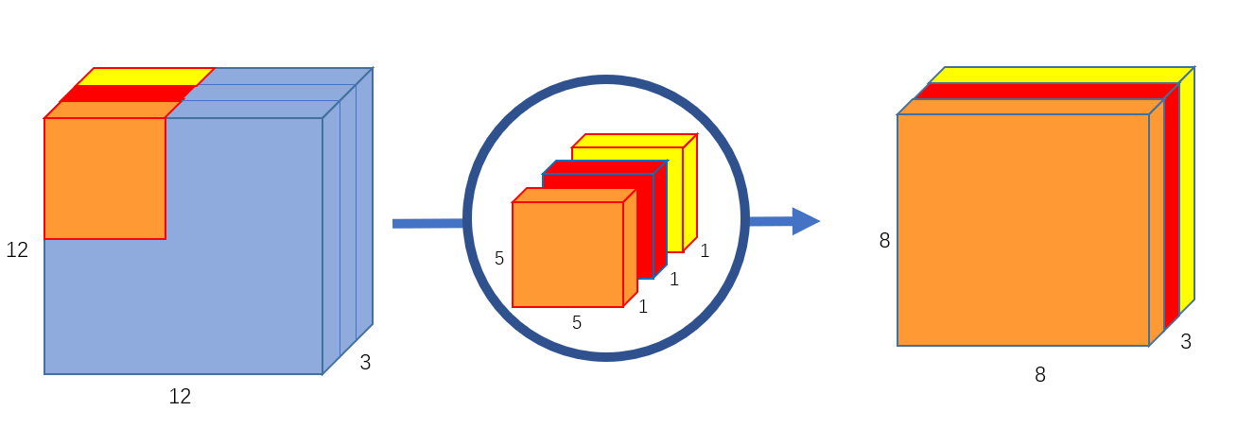
Depthwise Conv2D and Batch Normalization

Slide 14
Results
Model | Max Train Accuracy | Max Validation Accuracy | Training Loss | Validation Loss | Epoch Ceiling
Baseline | 96% | 41% | 0.21 | 2.8 | 3
Model 2 | 97% | 59% | 0.08 | 2.29 | 4
Model 3 | 94% | 62% | 0.17 | 2.2 | 5
Model 4 | 68% | 65% | 0.9 | 1.12 | 20+
Model 5 | 89% | 95% | 0.3 | 0.16 | 10+

